Slide 1


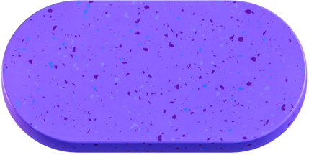

BY BAHLOUL MUBARIK
LAND REGISTRY SYSTEM
BLOCKCHAIN BASED LAND REGISTRY SYSTEM TO REDUCE FRAUD

Slide 2
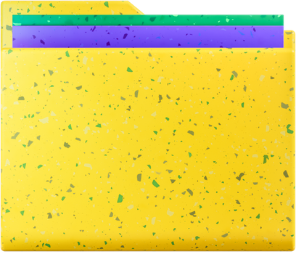

Overview
Our project uses blockchain technology to create a system for land ownership transfer, which accelerates and simplifies the registration process while reducing fraud and removing intermediaries.
OBJECTIVES
GOALS
make process faster and easier secure and immutable records Provide a decentralized platform for buyers, sellers
Help protect the rights of landowners,
To remove intermediaries like property dealers
increase the transparency and trustworthiness
decreases the cases of fraud
Back to Agenda Page

Slide 3
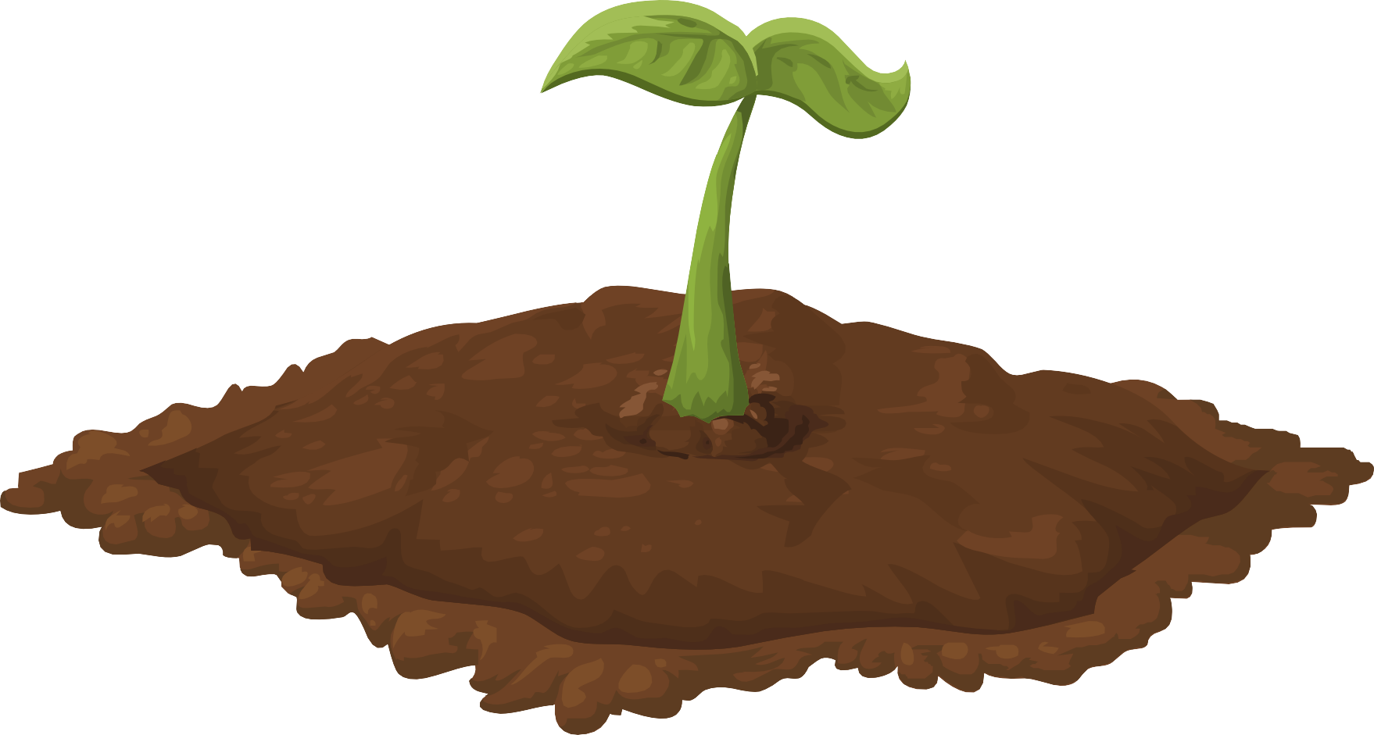

PROJECT STEPS
IEC

Slide 4
PROBLEM STATEMENT
The current process of land registration is slow and involves intermediaries, leading to delays, errors, and fraud. Our project aims to use a blockchain-based system on Ethereum to facilitate fast and secure transfer of ownership. This will eliminate intermediaries, increase transparency, and enable validation of land ownership. The system will protect the owner's rights, prevent fraud, resolve disputes, and ensure accurate record- keeping

Slide 5
ADVANTAGES
advantages of using a blockchain-based system for land ownership transfer are:
Increased speed and efficiency of the land registration process.
Removal of intermediaries, resulting in cost-effectiveness and transparency.
Security and immutability of transactions, reducing the risk of fraud and errors.
Increased accuracy and validation of land ownership.
Protection of the owner's rights and prevention of sale frauds.
Resolution of disputes in a more efficient and transparent manner.
Improved record-keeping and data management.

Slide 6









STAKEHOLDERS
Buyer: A person who is interested in buying the land and uses the platform to search the property, request access and interact with the seller and get the land title ownership.
Seller: A person who is interested in selling the land and uses the platform to manage property’s details and transfer land title to buyers
Land Inspector: a person who audits the land transferring process and acts as alegal body under whose supervision this buying and selling is done.

Slide 7

PART 1
REGISTER SELLER AND LAND
starting with the registration of sellers. Sellers are required to provide their details, which are then verified by a land inspector to ensure their legitimacy. If the seller is verified, they can then upload the details of the land they wish to sell. The land details are also verified by the land inspector to ensure they are accurate and truthful. Sellers can update their details on the platform if needed, and users can check if a seller has been verified or not. This is useful for buyers who want to ensure they are purchasing land from a legitimate seller. Users can also verify the ownership of a particular piece of land by its unique LandID. This is useful for buyers who want to ensure they are purchasing land from the correct owner.

Slide 8


BUYER PROCESS
The first step is to register as a Buyer by providing personal information in the system. The registration will then be verified by the land inspector, who will approve or reject the Buyer's registration.
Buyers can update their personal information at any time in the system. The system provides a way to check if the Buyer has been verified or not using a Boolean value.
The system also allows Buyers to check the current owner of a particular piece of land. To buy a piece of land, the Buyer must be verified and the land must also be verified. Once the Buyer provides the amount and the land ID, the ownership of the land will be transferred from the current owner to the new Owner in the system.

Slide 9
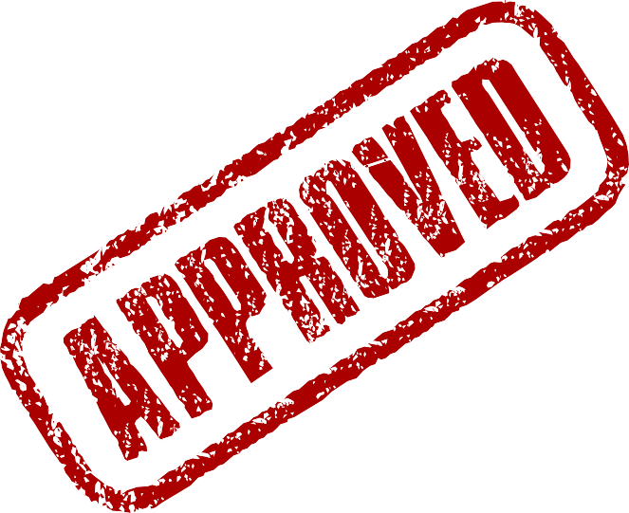
OWNERSHIP
after buying land, current landowners to transfer ownership of their land to a new address. before inspector will verify land and owner after verification ownership will be transfer to new owner.

